Slide 1

Linear Sort
"Our intuition about the future is linear. But the reality of information technology is exponential, and that makes a profound difference. If I take 30 steps linearly, I get to 30. If I take 30 steps exponentially, I get to a billion."
-Ray Kurzweil
CLRS, Sections 8.1 – 8.3

Slide 2
Lower Bound for Sorting
All the sorting algorithms seen so far are called comparison sorts.
They sort by using comparison operations between the array elements.
We can show that any comparison sort must make Ω(n*log(n)) comparisons in the worst case to sort n elements.

Slide 3
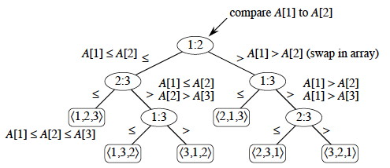
Lower Bound for Sorting
Decision Tree Model: Full binary tree representing comparison between array elements performed by sorting algorithm.
Internal nodes represent comparisons.
Leaves represent outcomes.
All array elements permutations.
Example: Decision tree for Insertion Sort of 3 elements.

Slide 4
Lower Bound for Sorting
Worst-case number of comparisons:
Length of the longest simple path from the root to any leaves in the decision tree (i.e. tree height).
Possible outcomes:
Total number of permutations = n!
Therefore, the decision tree has at least n! leaves.
In general, a decision tree of height h has 2^{h} leaves.
Thus, we have
n! ≤ 2^{h}
h ≥ log₂(n!)
Using Stirling’s approximation:
n! > (n/e)^{n}
h ≥ log₂((n/e)^{n}) =
n*log₂(n/e) = n*log₂n - n*log₂e
h = Ω(n*log(n))

Slide 5
Lower Bound for Sorting
Theorem: Any comparison sort algorithm requires Ω(n*log(n)) comparisons in the worst case.
Linearithmic sorting algorithms, like Heapsort, Quicksort, and Merge Sort, have a worst-case running time of O(n*log(n)).
Corollary: Linearithmic sorting algorithms are asymptotically optimal for comparison sort.

Slide 6
Can we do better?

Slide 7
Sorting in Linear Time
Comparison Sort:
Lower bound: Ω(n*log(n))
Non-Comparison Sorts:
Possible to sort in linear time.
Under certain assumptions.
Examples:
Counting Sort
Radix Sort

Slide 8
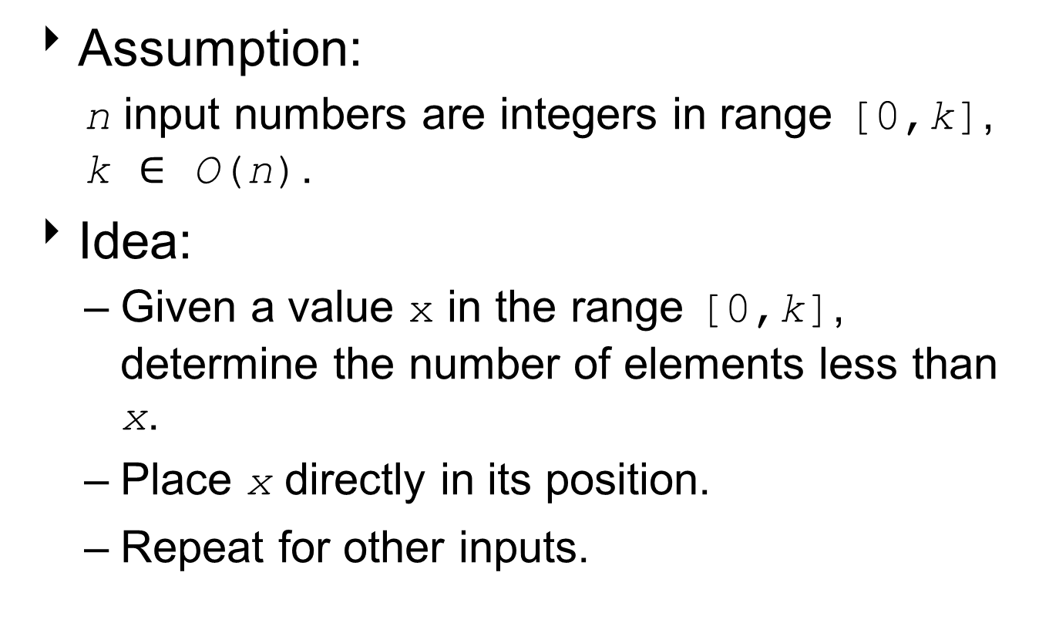
Counting Sort
Assumption:
n input numbers are integers in range [0,k], k $∈$ O(n).
Idea:
Given a value x in the range [0,k], determine the number of elements less than x.
Place x directly in its position.
Repeat for other inputs.

Slide 9
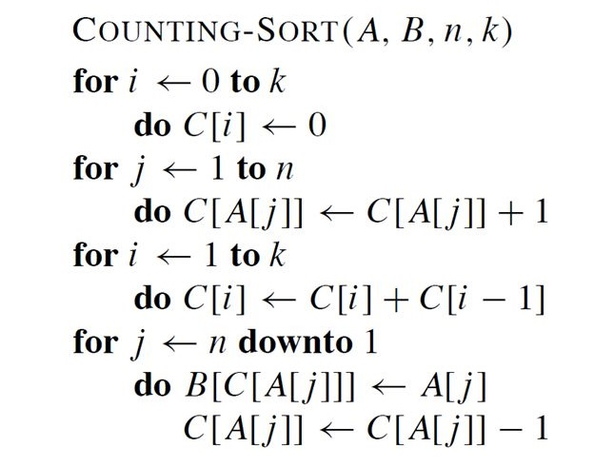
Count Sort Algorithm
// A: indexed list of unsorted values
// B: indexed list of values in A, sorted
// n: number of values in A, B
// k: max value of values in A
// C: number of each value
// in the range from 0 to k
// Find location of last C[i]
// Put values in
// correct location
// in B

Slide 10
Example: Counting Sort
A:
1 | 2 | 3 | 4 | 5 | 6 | 7 | 8
2 | 5 | 3 | 0 | 2 | 3 | 0 | 3
C:
0 | 1 | 2 | 3 | 4 | 5
B:
1 | 2 | 3 | 4 | 5 | 6 | 7 | 8

Slide 11
Example: Counting Sort
A:
1 | 2 | 3 | 4 | 5 | 6 | 7 | 8
2 | 5 | 3 | 0 | 2 | 3 | 0 | 3
for i ← 0 to k
do C[i] ← 0
// initialize to 0
C:
0 | 1 | 2 | 3 | 4 | 5
0 | 0 | 0 | 0 | 0 | 0
B:
1 | 2 | 3 | 4 | 5 | 6 | 7 | 8

Slide 12
Example: Counting Sort
A:
1 | 2 | 3 | 4 | 5 | 6 | 7 | 8
2 | 5 | 3 | 0 | 2 | 3 | 0 | 3
for j ← 1 to length[A]
do C[A[j]] ← C[A[j]] + 1
// count elements // equal to i
C:
0 | 1 | 2 | 3 | 4 | 5
0 | 0 | 0 | 0 | 0 | 0
B:
1 | 2 | 3 | 4 | 5 | 6 | 7 | 8

Slide 13
Example: Counting Sort
A:
1 | 2 | 3 | 4 | 5 | 6 | 7 | 8
2 | 5 | 3 | 0 | 2 | 3 | 0 | 3
for j ← 1 to length[A]
do C[A[j]] ← C[A[j]] + 1
j = 1
C[2] ← 0 + 1
C:
0 | 1 | 2 | 3 | 4 | 5
0 | 0 | 1 | 0 | 0 | 0
B:
1 | 2 | 3 | 4 | 5 | 6 | 7 | 8

Slide 14
Example: Counting Sort
A:
1 | 2 | 3 | 4 | 5 | 6 | 7 | 8
2 | 5 | 3 | 0 | 2 | 3 | 0 | 3
for j ← 1 to length[A]
do C[A[j]] ← C[A[j]] + 1
j = 2
C[5] ← 0 + 1
C:
0 | 1 | 2 | 3 | 4 | 5
0 | 0 | 1 | 0 | 0 | 1
B:
1 | 2 | 3 | 4 | 5 | 6 | 7 | 8

Slide 15
Example: Counting Sort
A:
1 | 2 | 3 | 4 | 5 | 6 | 7 | 8
2 | 5 | 3 | 0 | 2 | 3 | 0 | 3
for j ← 1 to length[A]
do C[A[j]] ← C[A[j]] + 1
j = 3
C[3] ← 0 + 1
C:
0 | 1 | 2 | 3 | 4 | 5
0 | 0 | 1 | 1 | 0 | 1
B:
1 | 2 | 3 | 4 | 5 | 6 | 7 | 8

Slide 16
Example: Counting Sort
A:
1 | 2 | 3 | 4 | 5 | 6 | 7 | 8
2 | 5 | 3 | 0 | 2 | 3 | 0 | 3
for j ← 1 to length[A]
do C[A[j]] ← C[A[j]] + 1
j = 4
C[0] ← 0 + 1
C:
0 | 1 | 2 | 3 | 4 | 5
1 | 0 | 1 | 1 | 0 | 1
B:
1 | 2 | 3 | 4 | 5 | 6 | 7 | 8

Slide 17
Example: Counting Sort
A:
1 | 2 | 3 | 4 | 5 | 6 | 7 | 8
2 | 5 | 3 | 0 | 2 | 3 | 0 | 3
for j ← 1 to length[A]
do C[A[j]] ← C[A[j]] + 1
j = 5
C[2] ← 1 + 1
C:
0 | 1 | 2 | 3 | 4 | 5
1 | 0 | 2 | 1 | 0 | 1
B:
1 | 2 | 3 | 4 | 5 | 6 | 7 | 8

Slide 18
Example: Counting Sort
A:
1 | 2 | 3 | 4 | 5 | 6 | 7 | 8
2 | 5 | 3 | 0 | 2 | 3 | 0 | 3
for j ← 1 to length[A]
do C[A[j]] ← C[A[j]] + 1
j = 6
C[3] ← 1 + 1
C:
0 | 1 | 2 | 3 | 4 | 5
1 | 0 | 2 | 2 | 0 | 1
B:
1 | 2 | 3 | 4 | 5 | 6 | 7 | 8

Slide 19
Example: Counting Sort
A:
1 | 2 | 3 | 4 | 5 | 6 | 7 | 8
2 | 5 | 3 | 0 | 2 | 3 | 0 | 3
for j ← 1 to length[A]
do C[A[j]] ← C[A[j]] + 1
j = 7
C[0] ← 1 + 1
C:
0 | 1 | 2 | 3 | 4 | 5
2 | 0 | 2 | 2 | 0 | 1
B:
1 | 2 | 3 | 4 | 5 | 6 | 7 | 8

Slide 20
Example: Counting Sort
A:
1 | 2 | 3 | 4 | 5 | 6 | 7 | 8
2 | 5 | 3 | 0 | 2 | 3 | 0 | 3
for j ← 1 to length[A]
do C[A[j]] ← C[A[j]] + 1
j = 8
C[0] ← 2 + 1
C:
0 | 1 | 2 | 3 | 4 | 5
2 | 0 | 2 | 3 | 0 | 1
B:
1 | 2 | 3 | 4 | 5 | 6 | 7 | 8

Slide 21
Example: Counting Sort
A:
1 | 2 | 3 | 4 | 5 | 6 | 7 | 8
2 | 5 | 3 | 0 | 2 | 3 | 0 | 3
for i ← 1 to k
do C[i] ← C[i] + C[i - 1]
// sum number of // elements ≤ i
C:
0 | 1 | 2 | 3 | 4 | 5
2 | 0 | 2 | 3 | 0 | 1
B:
1 | 2 | 3 | 4 | 5 | 6 | 7 | 8

Slide 22
Example: Counting Sort
A:
1 | 2 | 3 | 4 | 5 | 6 | 7 | 8
2 | 5 | 3 | 0 | 2 | 3 | 0 | 3
for i ← 1 to k
do C[i] ← C[i] + C[i - 1]
i = 1
C[1] ← 0 + 2
C:
0 | 1 | 2 | 3 | 4 | 5
2 | 2 | 2 | 3 | 0 | 1
B:
1 | 2 | 3 | 4 | 5 | 6 | 7 | 8

Slide 23
Example: Counting Sort
A:
1 | 2 | 3 | 4 | 5 | 6 | 7 | 8
2 | 5 | 3 | 0 | 2 | 3 | 0 | 3
for i ← 1 to k
do C[i] ← C[i] + C[i - 1]
i = 2
C[2] ← 2 + 2
C:
0 | 1 | 2 | 3 | 4 | 5
2 | 2 | 4 | 3 | 0 | 1
B:
1 | 2 | 3 | 4 | 5 | 6 | 7 | 8

Slide 24
Example: Counting Sort
A:
1 | 2 | 3 | 4 | 5 | 6 | 7 | 8
2 | 5 | 3 | 0 | 2 | 3 | 0 | 3
for i ← 1 to k
do C[i] ← C[i] + C[i - 1]
i = 3
C[3] ← 3 + 4
C:
0 | 1 | 2 | 3 | 4 | 5
2 | 2 | 4 | 7 | 0 | 1
B:
1 | 2 | 3 | 4 | 5 | 6 | 7 | 8

Slide 25
Example: Counting Sort
A:
1 | 2 | 3 | 4 | 5 | 6 | 7 | 8
2 | 5 | 3 | 0 | 2 | 3 | 0 | 3
for i ← 1 to k
do C[i] ← C[i] + C[i - 1]
i = 4
C[4] ← 0 + 7
C:
0 | 1 | 2 | 3 | 4 | 5
2 | 2 | 4 | 7 | 7 | 1
B:
1 | 2 | 3 | 4 | 5 | 6 | 7 | 8

Slide 26
Example: Counting Sort
A:
1 | 2 | 3 | 4 | 5 | 6 | 7 | 8
2 | 5 | 3 | 0 | 2 | 3 | 0 | 3
for i ← 1 to k
do C[i] ← C[i] + C[i - 1]
i = 5
C[5] ← 1 + 7
C:
0 | 1 | 2 | 3 | 4 | 5
2 | 2 | 4 | 7 | 7 | 8
B:
1 | 2 | 3 | 4 | 5 | 6 | 7 | 8

Slide 27
Example: Counting Sort
A:
1 | 2 | 3 | 4 | 5 | 6 | 7 | 8
2 | 5 | 3 | 0 | 2 | 3 | 0 | 3
C:
0 | 1 | 2 | 3 | 4 | 5
2 | 2 | 4 | 7 | 7 | 8
for j ← length[A] downto 1
do B[C[A[j]]] ← A[j]
C[A[j]] ← C[A[j]] - 1
// insert elements // at final position
B:
1 | 2 | 3 | 4 | 5 | 6 | 7 | 8

Slide 28
Example: Counting Sort
A:
1 | 2 | 3 | 4 | 5 | 6 | 7 | 8
2 | 5 | 3 | 0 | 2 | 3 | 0 | 3
C:
0 | 1 | 2 | 3 | 4 | 5
2 | 2 | 4 | 6 | 7 | 8
for j ← length[A] downto 1
do B[C[A[j]]] ← A[j]
C[A[j]] ← C[A[j]] - 1
j = 8
B[7] ← A[8]
C[3] ← 7 - 1
B:
1 | 2 | 3 | 4 | 5 | 6 | 7 | 8
 |  |  |  |  |  | 3

Slide 29
Example: Counting Sort
A:
1 | 2 | 3 | 4 | 5 | 6 | 7 | 8
2 | 5 | 3 | 0 | 2 | 3 | 0 | 3
C:
0 | 1 | 2 | 3 | 4 | 5
1 | 2 | 4 | 6 | 7 | 8
for j ← length[A] downto 1
do B[C[A[j]]] ← A[j]
C[A[j]] ← C[A[j]] - 1
j = 7
B[2] ← A[7]
C[0] ← 2 - 1
B:
1 | 2 | 3 | 4 | 5 | 6 | 7 | 8
 | 0 |  |  |  |  | 3

Slide 30
Example: Counting Sort
A:
1 | 2 | 3 | 4 | 5 | 6 | 7 | 8
2 | 5 | 3 | 0 | 2 | 3 | 0 | 3
C:
0 | 1 | 2 | 3 | 4 | 5
1 | 2 | 4 | 5 | 7 | 8
for j ← length[A] downto 1
do B[C[A[j]]] ← A[j]
C[A[j]] ← C[A[j]] - 1
j = 6
B[6] ← A[6]
C[3] ← 6 - 1
B:
1 | 2 | 3 | 4 | 5 | 6 | 7 | 8
 | 0 |  |  |  | 3 | 3

Slide 31
Example: Counting Sort
A:
1 | 2 | 3 | 4 | 5 | 6 | 7 | 8
2 | 5 | 3 | 0 | 2 | 3 | 0 | 3
C:
0 | 1 | 2 | 3 | 4 | 5
1 | 2 | 3 | 5 | 7 | 8
for j ← length[A] downto 1
do B[C[A[j]]] ← A[j]
C[A[j]] ← C[A[j]] - 1
j = 5
B[4] ← A[5]
C[2] ← 4 - 1
B:
1 | 2 | 3 | 4 | 5 | 6 | 7 | 8
 | 0 |  | 2 |  | 3 | 3

Slide 32
Example: Counting Sort
A:
1 | 2 | 3 | 4 | 5 | 6 | 7 | 8
2 | 5 | 3 | 0 | 2 | 3 | 0 | 3
C:
0 | 1 | 2 | 3 | 4 | 5
0 | 2 | 3 | 5 | 7 | 8
for j ← length[A] downto 1
do B[C[A[j]]] ← A[j]
C[A[j]] ← C[A[j]] - 1
j = 4
B[1] ← A[4]
C[0] ← 1 - 1
B:
1 | 2 | 3 | 4 | 5 | 6 | 7 | 8
0 | 0 |  | 2 |  | 3 | 3

Slide 33
Example: Counting Sort
A:
1 | 2 | 3 | 4 | 5 | 6 | 7 | 8
2 | 5 | 3 | 0 | 2 | 3 | 0 | 3
C:
0 | 1 | 2 | 3 | 4 | 5
0 | 2 | 3 | 4 | 7 | 8
for j ← length[A] downto 1
do B[C[A[j]]] ← A[j]
C[A[j]] ← C[A[j]] - 1
j = 3
B[5] ← A[3]
C[3] ← 5 - 1
B:
1 | 2 | 3 | 4 | 5 | 6 | 7 | 8
0 | 0 |  | 2 | 3 | 3 | 3

Slide 34
Example: Counting Sort
A:
1 | 2 | 3 | 4 | 5 | 6 | 7 | 8
2 | 5 | 3 | 0 | 2 | 3 | 0 | 3
C:
0 | 1 | 2 | 3 | 4 | 5
0 | 2 | 3 | 4 | 7 | 7
for j ← length[A] downto 1
do B[C[A[j]]] ← A[j]
C[A[j]] ← C[A[j]] - 1
j = 2
B[8] ← A[2]
C[3] ← 8 - 1
B:
1 | 2 | 3 | 4 | 5 | 6 | 7 | 8
0 | 0 |  | 2 | 3 | 3 | 3 | 5

Slide 35
Example: Counting Sort
A:
1 | 2 | 3 | 4 | 5 | 6 | 7 | 8
2 | 5 | 3 | 0 | 2 | 3 | 0 | 3
C:
0 | 1 | 2 | 3 | 4 | 5
0 | 2 | 2 | 4 | 7 | 7
for j ← length[A] downto 1
do B[C[A[j]]] ← A[j]
C[A[j]] ← C[A[j]] - 1
j = 1
B[3] ← A[1]
C[2] ← 2 - 1
B:
1 | 2 | 3 | 4 | 5 | 6 | 7 | 8
0 | 0 | 2 | 2 | 3 | 3 | 3 | 5

Slide 36
Example: Counting Sort
A:
1 | 2 | 3 | 4 | 5 | 6 | 7 | 8
2 | 5 | 3 | 0 | 2 | 3 | 0 | 3
C:
0 | 1 | 2 | 3 | 4 | 5
0 | 2 | 2 | 4 | 7 | 7
Sorted
B:
1 | 2 | 3 | 4 | 5 | 6 | 7 | 8
0 | 0 | 2 | 2 | 3 | 3 | 3 | 5

Slide 37
Analysis of Count Sort
COUNTING-SORT(A, B, k)
for i← 0 to k [Loop 1]
do C[i] ←0
for j ← 1 to length[A] [Loop 2]
do C[A[j]] ← C[A[j]] + 1
// C[i] contains number of elements equal to i.
for i ← 1 to k [Loop 3]
do C[i] ← C[i] + C[i - 1]
// C[i] contains number of elements ≤ i.
for j ← length[A] downto 1 [Loop 4]
do B[C[A[j]]] ← A[j]
C[A[j]] ← C[A[j]] – 1
Total cost is Θ(k+n). If k = O(n), then total cost is Θ(n).
Loops 1 and 3 takes Θ(k) time
Loops 2 and 4 takes Θ(n) time

Slide 38
Radix Sort
Radix Sort dates back as far as 1887.
Herman Hollerith used technique in tabulating machines.
The1880 U.S. census took 7 years to complete.
With Hollerith's "tabulating machines," the 1890 census took the Census Bureau six weeks.
Radix sort is another non-comparative sorting algorithm.
Sorts data with integer keys with d digits.
Sort least significant digits first, then sort the 2nd one, then the 3rd one, etc., up to d digits.

Slide 39
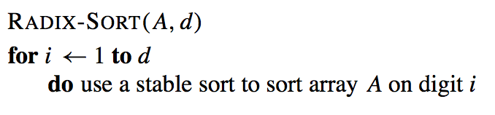
Radix Algorithm
Given an array of integers A with up to d digits:

Slide 40
Stable Sorting
Stability is a property of sorts.
If a sort guarantees the relative order of equal items stays the same, then it is a stable sort.
For instance:
[7₁, 6, 7₂, 5, 1, 2, 7₃, -5]
subscripts added for clarity
[-5, 1, 2, 5, 6, 7₁, 7₂, 7₃]
result of stable sort
Real world examples:
Sort playing cards by suit, then by value.
Sort people by state of residence, then by city.

Slide 41
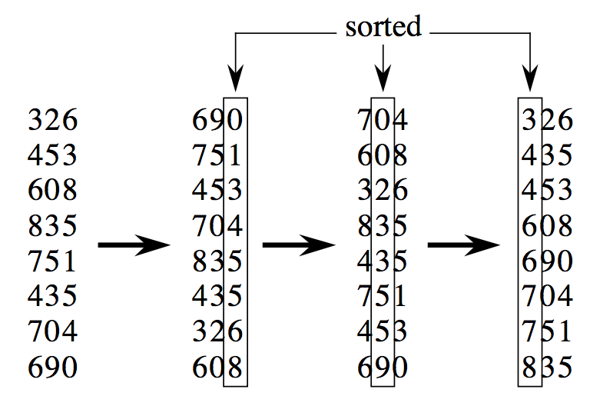
Example: Radix Sort
Input array:
3-digit elements
Sort the least significant digit
Sort the next significant digit
Sort the last digit

Slide 42
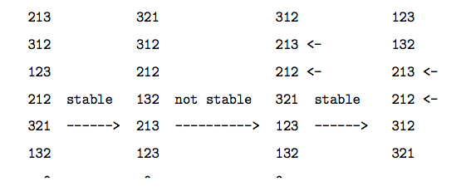
Stable Sort
What happens if we use a non-stable sorting algorithm?

Slide 43
Are Other Sorting Algorithms Stable?
Counting sort?
Stable
Insertion sort?
Stable
Heapsort?
Not Stable - example input: [5₁ 5₂ 5₃ 3 4]
output: [3 4 5₃ 5₂ 5₁]
Selection sort?
Not Stable - example input: [5₁ 5₂ 5₃ 3 4]
output: [3 4 5₃ 5₁ 5₂]
Quicksort?
Not Stable - example input: [5₁ 5₂ 5₃ 3 4]
output: [3 4 5₃ 5₁ 5₂]

Slide 44
Radix Sort for Non-Integers
Suppose a group of people, with last name, middle, and first name.
Sort it by the last name, then by middle, finally by the first name
Then after every pass of sort, the bins can be combined as one file and proceed to the next sort.

Slide 45
Analysis of Radix Sort
Assume list of n numbers with d or fewer digits.
If use Counting Sort to sort each digit,
the running time for Radix Sort would be:
d * Θ(n + k) = Θ(dn + dk)
where d = ⎿log_{k}(m)+ 1⏌, k is the base of the values being sorted and m is the largest value in the list.
If k = O(n) and d is a constant, the running time is Θ(n).

Slide 46
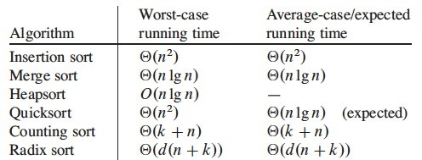
Comparison of Various Sorts

Slide 48
Bucket Sort
Assumption: uniform distribution
Input numbers are uniformly distributed in [0,1).
Suppose input size is n.
Idea:
Divide [0,1) into n equal-sized buckets.
Distribute n numbers into buckets
Expect that each bucket contains a few numbers.
Sort numbers in each bucket
usually, insertion sort as default
Then go through buckets in order, listing elements.

Slide 49
Bucket Sort Algorithm
BUCKET-SORT(A)
n ← A.length
for i ←1 to n
do insert A[i] into bucket B[⎣n*A[i]⎦]
for i ←0 to n-1
do sort bucket B[i] using insertion sort
Concatenate bucket B[0],B[1],…,B[n-1]

Slide 50
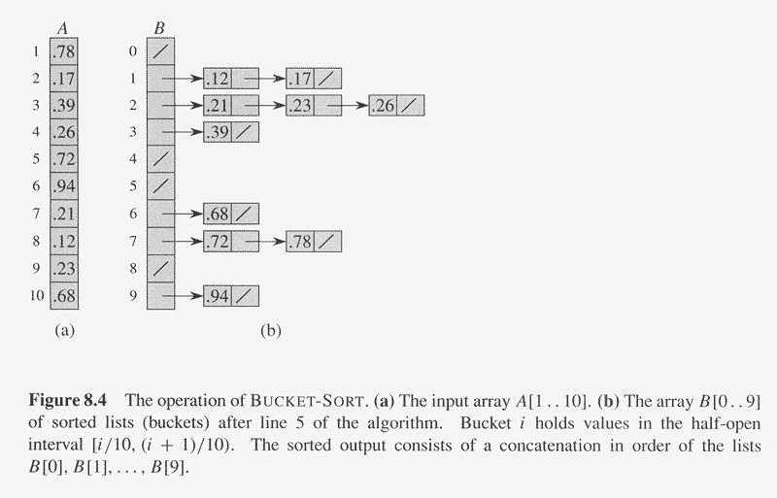
Example of Bucket Sort

Slide 51
Analysis of Bucket Sort
BUCKET-SORT(A)
n ←length[A] Ω(1)
for i ←1 to n O(n)
do insert A[i] into bucket B[⎣nA[i]⎦]
for i ←0 to n-1 O(n)
do sort bucket B[i] with insertion sort O(n_{i}²)
Concatenate bucket B[0],B[1],…,B[n-1] O(n)
Where n_{i} is the size of bucket B[i].
Thus, T(n) = Θ(n) + ∑_{i=0}^{n-1} O(n_{i}²)
= Θ(n) + n*O(2-1/n) = Θ(n)

Slide 52
Bucket sort algorithm
Algorithm BucketSort( S )
( values in S are between 0 and m-1 )
for j ← 0 to m-1 do // initialize m buckets
b[j] ← 0
for i ← 0 to n-1 do // place elements in their
b[S[i]] ← b[S[i]] + 1 // appropriate buckets
i ← 0
for j ← 0 to m-1 do // place elements in buckets
for r ← 1 to b[j] do // back in S
S[i] ← j
i ← i + 1

Slide 53
Bucket sort algorithm
Algorithm BucketSort( S )
( S is an array of entries whose keys are between 0..m-1 )
for j ← 0 to m-1 do // initialize m buckets
initialize queue b[j]
for i ← 0 to n-1 do // place in buckets
b[S[i].getKey()].enqueue( S[i] );
i ← 0
for j ← 0 to m-1 do // place elements in
while not b[j].isEmpty() do // buckets back in S
S[i] ← b[j].dequeue()
i ← i + 1

Slide 54
Example: 1st and 2nd passes
12 | 58 | 37 | 64 | 52 | 36 | 99 | 63 | 18 | 9 | 20 | 88 | 47
sort by rightmost digit
20 | 12 | 52 | 63 | 64 | 36 | 37 | 47 | 58 | 18 | 88 | 9 | 99
sort by leftmost digit
9 | 12 | 18 | 20 | 36 | 37 | 47 | 52 | 58 | 63 | 64 | 88 | 99

Slide 55
Radix Sort and Stability
Radix sort works as long as the bucket sort stages are stable sorts
Stability is a property of sorts:
A sort is stable if it guarantees the relative order of equal items stays the same
Given these numbers:
[7₁, 6, 7₂, 5, 1, 2, 7₃, -5] (subscripts added for clarity)
A stable sort would be:
[-5, 1, 2, 5, 6, 7₁, 7₂, 7₃]

